Slide 1
Quantum Languages
Eric Bond
Spring 2018

Slide 2
Outline
Motivation
Analogies from current language design
Dichotomy of research directions
Compiler level
Optimizing Assembly
Programming language level
Optimizing usability
Exploring alternative mathematical perspectives
Survey of existing languages
Quipper
Q#
Prior work

Slide 3
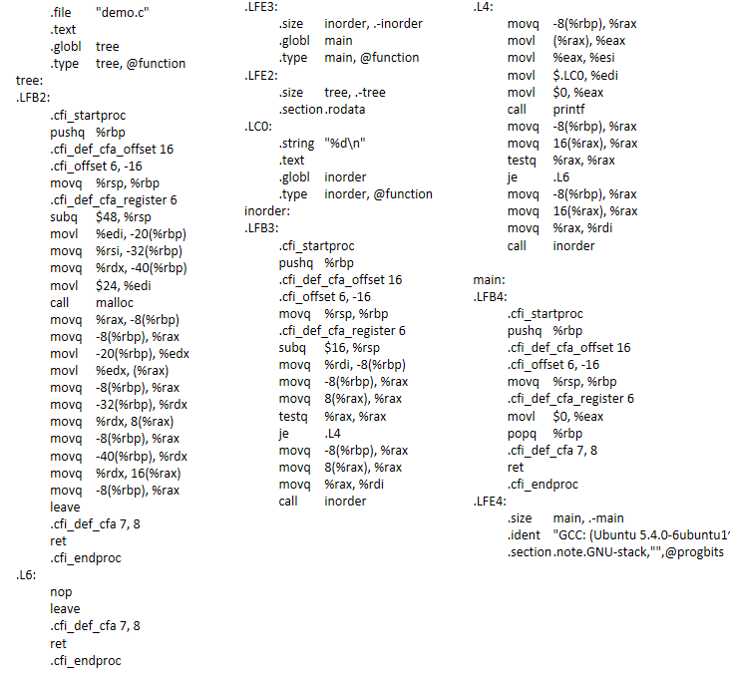
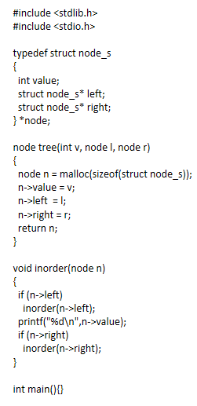

Why?
Haskell
x64 Assembly
C

Slide 4
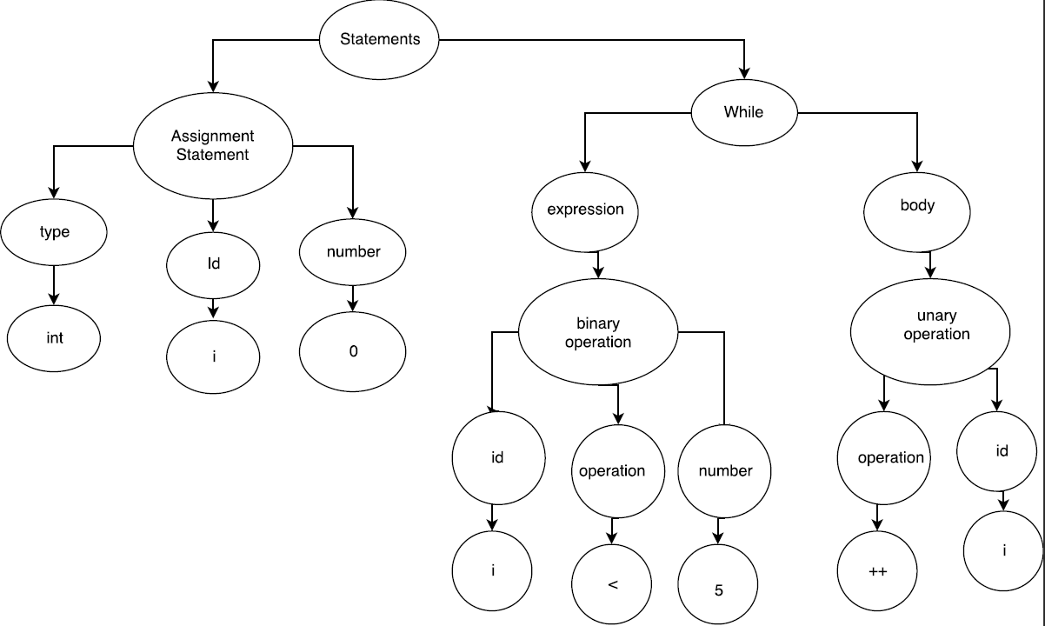
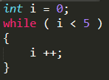
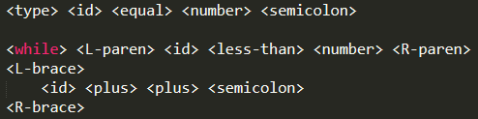
Research Direction - Compilers
Classical Compilers
Optimization
Code generation

Slide 5
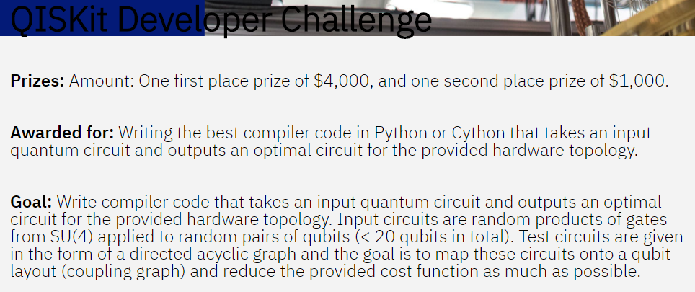
Research Direction - Compilers
Quantum Compilers – current and potential features
Decomposition of arbitrary unitary matrices
Optimal assembly code generation
Optimize for qubit chip topology
Algebraic rewrite rules
Single gate transforms
(u1 u2 u3 gates in QASM)
Qubit allocation and reuse
(modified graph coloring)
Error correction and decoherence prevention
Problem: physical vs logical qubit?
Steane codes
Qubit redundancy
Next steps?
Representation theory?

Slide 6
Research Directions – PL & Theory
Higher abstraction in QPL
How to adopt superposition and entanglement as language primitives?
What kinds of data types or data structures can we construct with qubits?
What are frequently occurring patterns in quantum algorithm design?
How to incorporate these patterns in language design?
How will quantum machines interface with classical machines programmatically?
How to reason about quantum circuits?

Slide 7
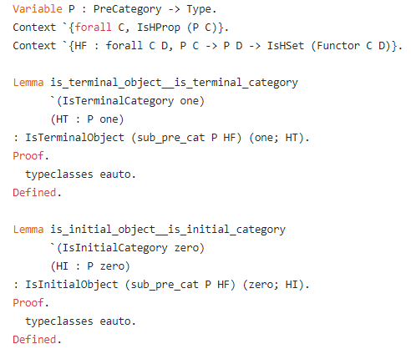
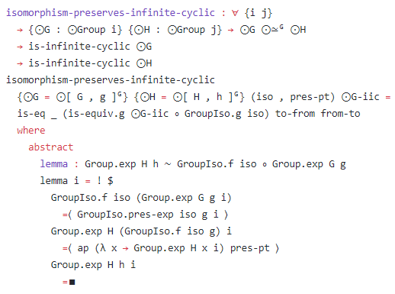
Programming Languages as Formal Systems
Coq
Source: https://github.com/HoTT/HoTT/blob/master/theories/Categories/Cat/Core.v
Agda
Source : https://github.com/HoTT/HoTT-Agda/blob/master/theorems/groups/Pointed.agda

Slide 8
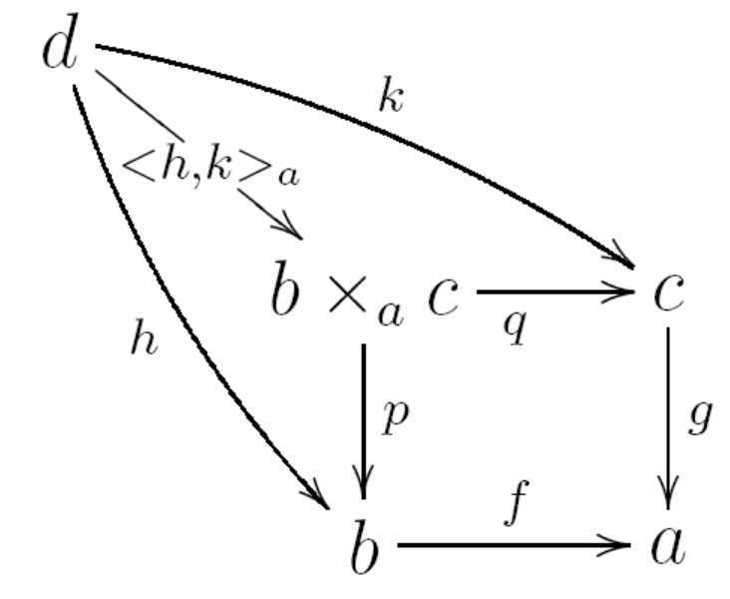

Higher Abstraction for Quantum Computing
First approximation
Applied Category Theory?
"As a first approximation, one could say that
category theory is the mathematical study of
the abstract algebras of functions“ - Awodey
Linear Logic?
Captures the notion of restriction of resource usage
Used to model measurement and no-cloning rules

Slide 9
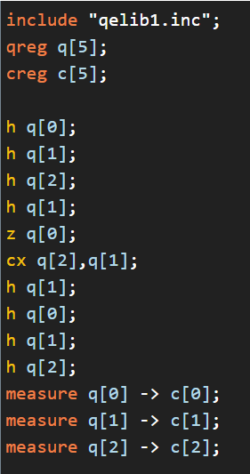
Current Philosophy
Quantum as a co-processor
High level classical languages generate quantum assembly
??

Slide 10
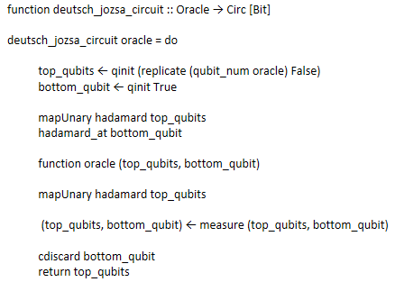
Quipper
Circuit description language
Model: Symmetric monoidal category
Has linear types
Aims for a unified model for parameters and state
Parameter: a value known at circuit generation time
State: a value known at circuit execution time
Quipper – quantum programming
Source: arXiv:1406.4481 [quant-ph]

Slide 11
Q#
Microsoft’s work
Embraces co-processor model
3 levels of computation
Classical computation that reads input data, sets up the quantum computation, triggers the quantum computation, processes the results of the computation, and presents the results to the user.
Quantum computation that happens directly in the quantum device and implements a quantum algorithm.
Classical computation that is required by the quantum algorithm during its execution.

Slide 12
References and Further reading
Categorical model for a quantum circuit description language – Rios & Selinger
Category theory – Awodey
Quantum programming languages: survey and bibliography – Gay
A taste of linear logic – Wadler
Physics topology logic computation : a rosetta stone – Baez
Categorical models for quantum computing - Wester
Open quantum assembly language – Cross, Bishop, Smolin, Gambetta
5 quantum algorithms using quipper - Selinger
Categorical quantum mechanics – Abramsky - Coecke
Q# website

